Slide 1
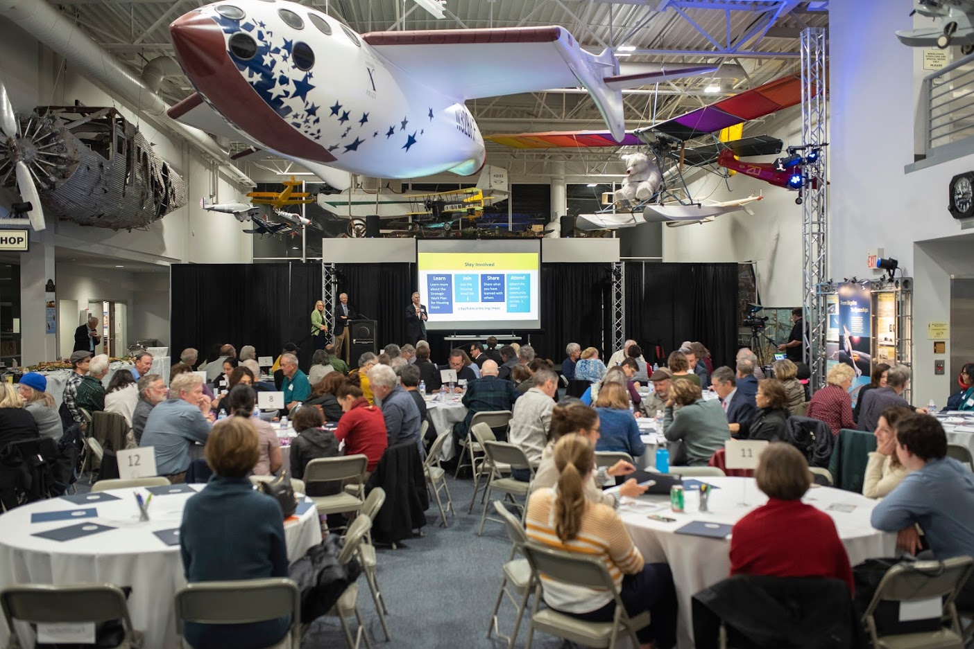


Slide 2





February 1 , 2020

Slide 3
INTRODUCTION & WELCOME
Welcome and thank you for joining us today.
Thank you also to our partners:
Home for All
Common Knowledge
Peninsula Conflict Resolution Center
Notes:
Here’s where we are today, and how we got here today.

Slide 4

MEETING GOALS
Broaden the conversation about housing and transportation in San Carlos
Provide a general overview of new state housing legislation
Create awareness and understanding of the current city actions and upcoming decisions related to housing
Notes:
Broaden the conversation about housing in San Carlos. This includes:
Review values and concerns we have heard so far
Develop shared understanding about current regional conditions
Explore the intersection of housing and transportation
Provide a general overview of the new state housing legislation to help explain the parameters for planning at the local level
Create awareness and understanding of the current city actions and upcoming decisions related to housing

Slide 5
HOME FOR ALL
A community collaborative addressing the housing challenge in San Mateo County
    Educating
    Innovating
    Convening
Notes:
Here’s where we are today, and how we got here today.

Slide 6
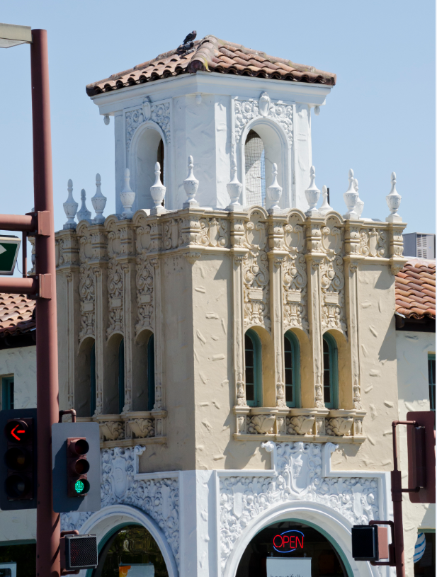
Agenda
Goal: Learning together
What we’ve heard so far
Housing and transportation
Discussion #1
State changes around housing laws and local impact
Options for San Carlos
Discussion #2
Next Steps

Slide 7
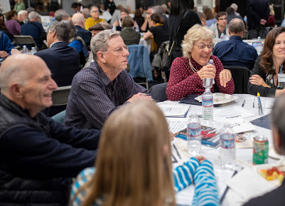
CONVERSATION GUIDELINES
Speak from your own experience
Listen to understand each other
Respect differences; be curious
Let everyone participate
Your questions are valuable

Slide 8
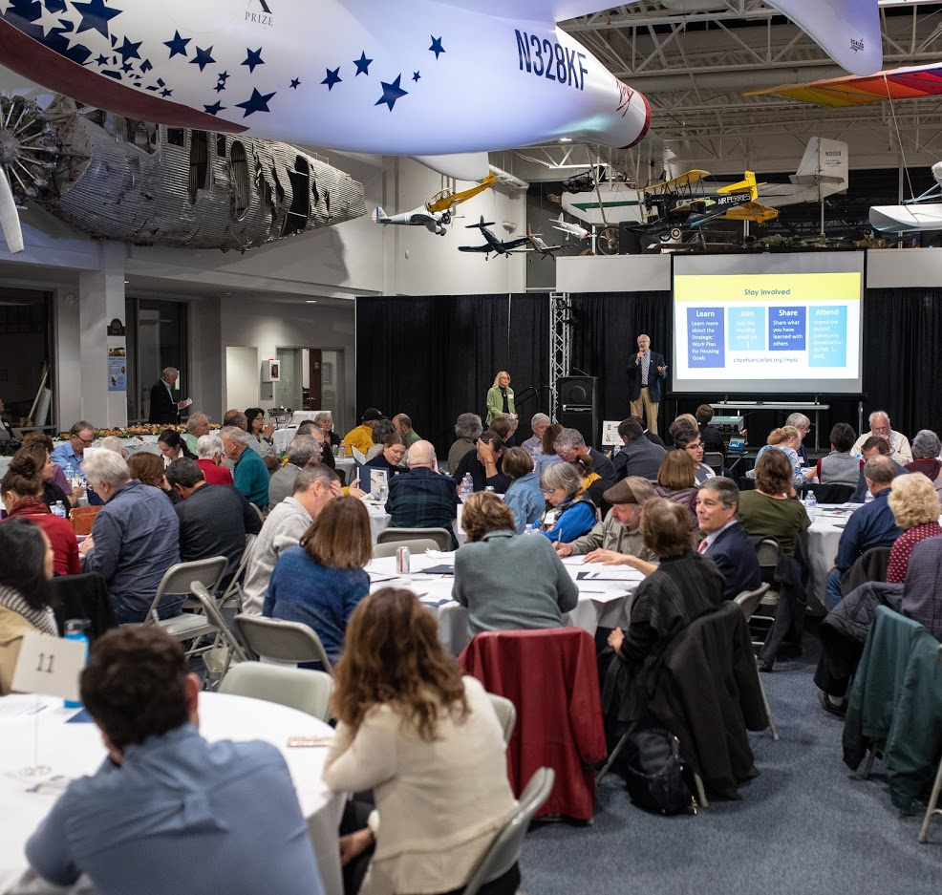
Think, Pair, Share
Take :90 each to share:
When did you help someone in our community or someone helped you?
What happened as a result?

Slide 9
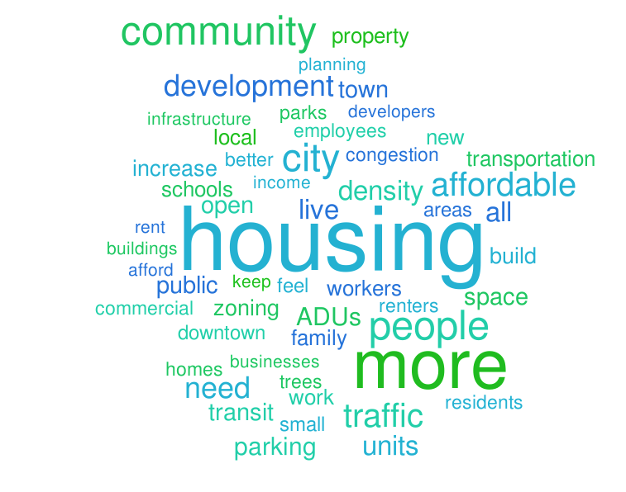

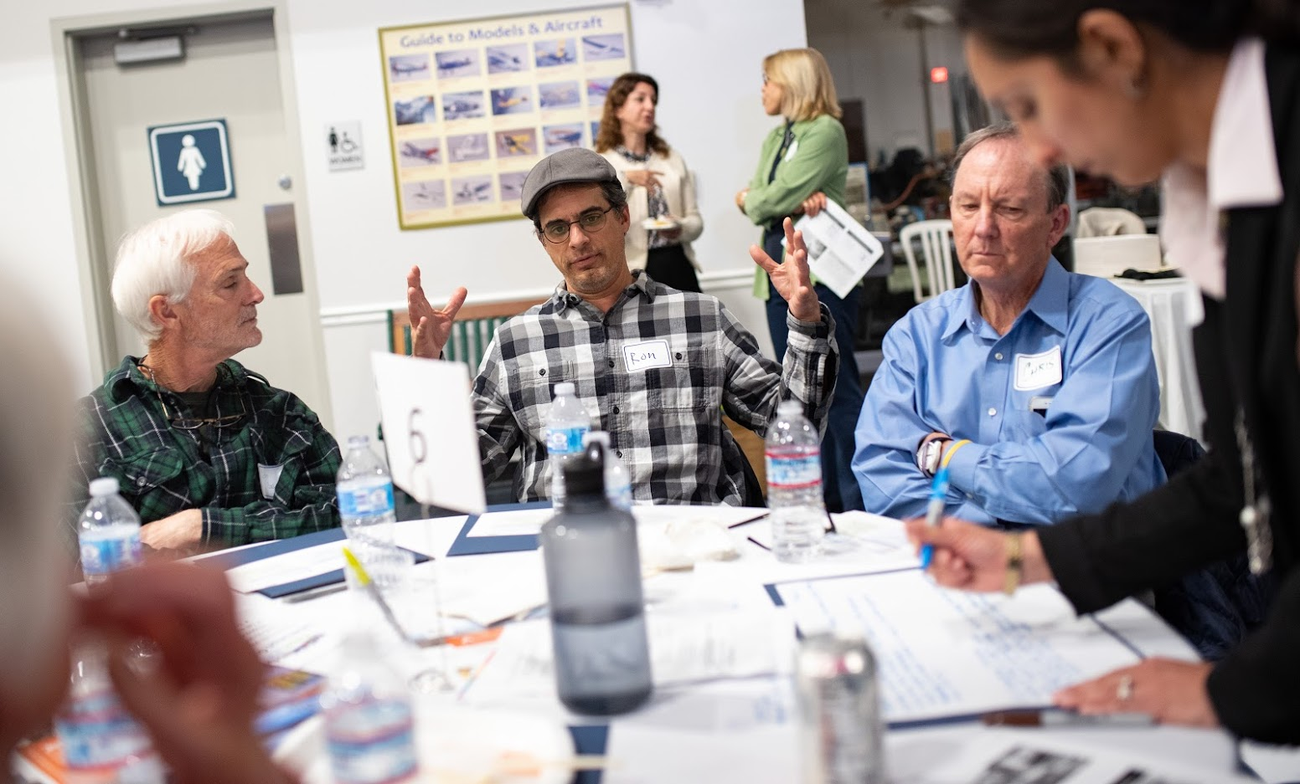
November 7, 2019 Meeting Highlights
Notes:
On Nov. 7, 2019-100 community members, CC members, and staff gathered for first Welcome Home San Carlos community conversation at the Hiller Aviation Center for an evening to compare experiences and share their hopes for San Carlos’ future. Similar to the outreach efforts leading up to this meeting, staff reached out to a wide range of groups in the San Carlos community. This word bubble highlights what we heard and how the issue of housing affects people in San Carlos. Growth, public transportation, desire to support family-owned businesses, traffic, and diversity were some of the main topics.

Slide 10
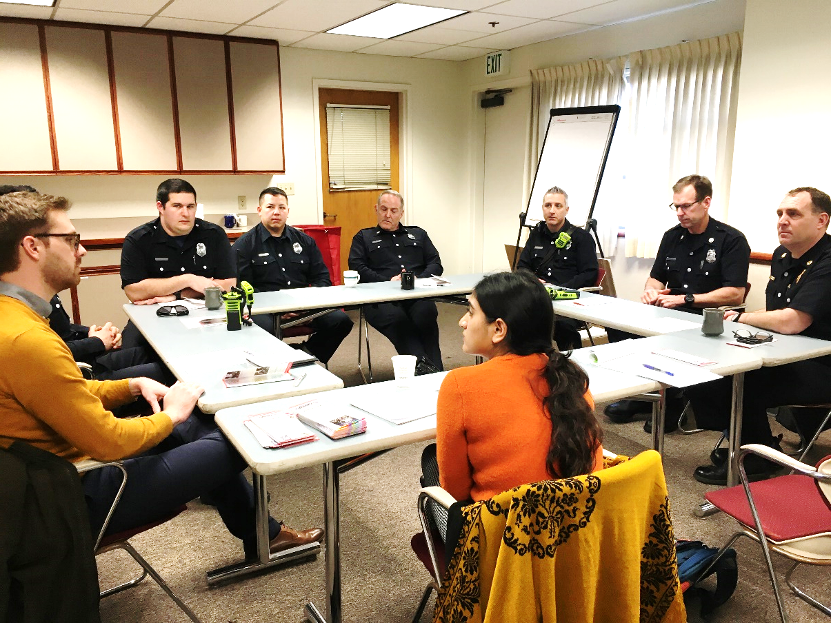
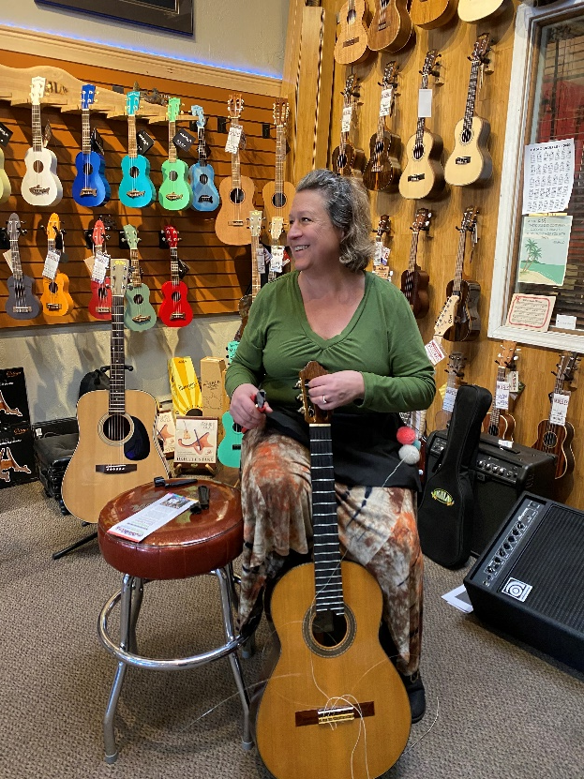
Who we talked to and what we heard
Police
Teachers
Downtown employees
Parents
Firefighters
Notes:
Since the November meeting, we’ve been continuing with outreach efforts and got to speak with service providers including police, firefighters, teachers. We also spoke with parents, downtown employees, and other community members to better understand their experiences with housing.
What we heard revolves around:
Housing in San Carlos is too expensive for service providers such as teachers, firefighters, and police.
Utilizing public transit is often not logistically feasible for most commuters
Small town feel that’s at risk for overgrowth with traffic, congestion, and parking issues
Rising home prices make it unaffordable for young adults and young families
The new apartments and condos being built are not for the working class and simply unaffordable

Slide 11
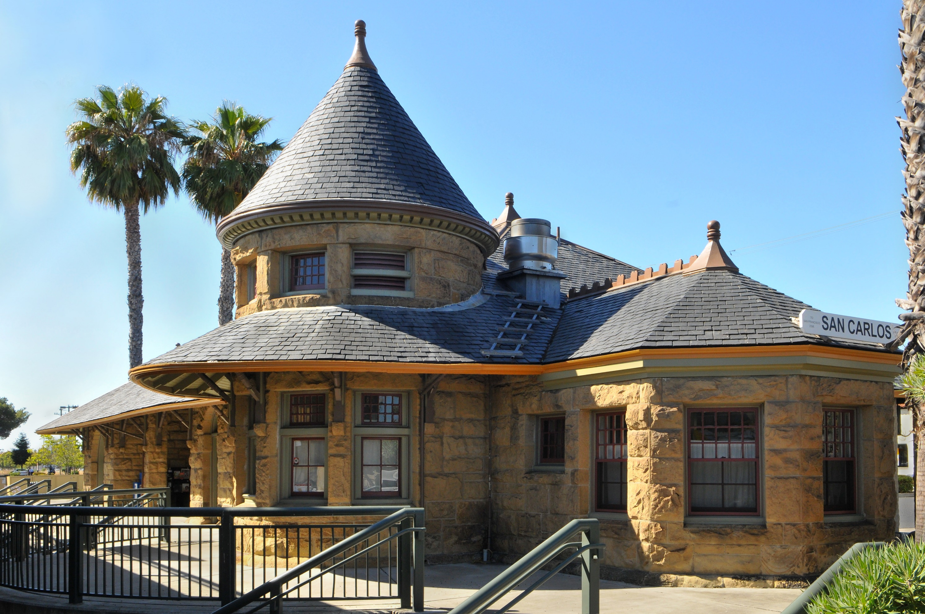


About San Carlos:
Regional Challenges & Quality of Life Data

Slide 12
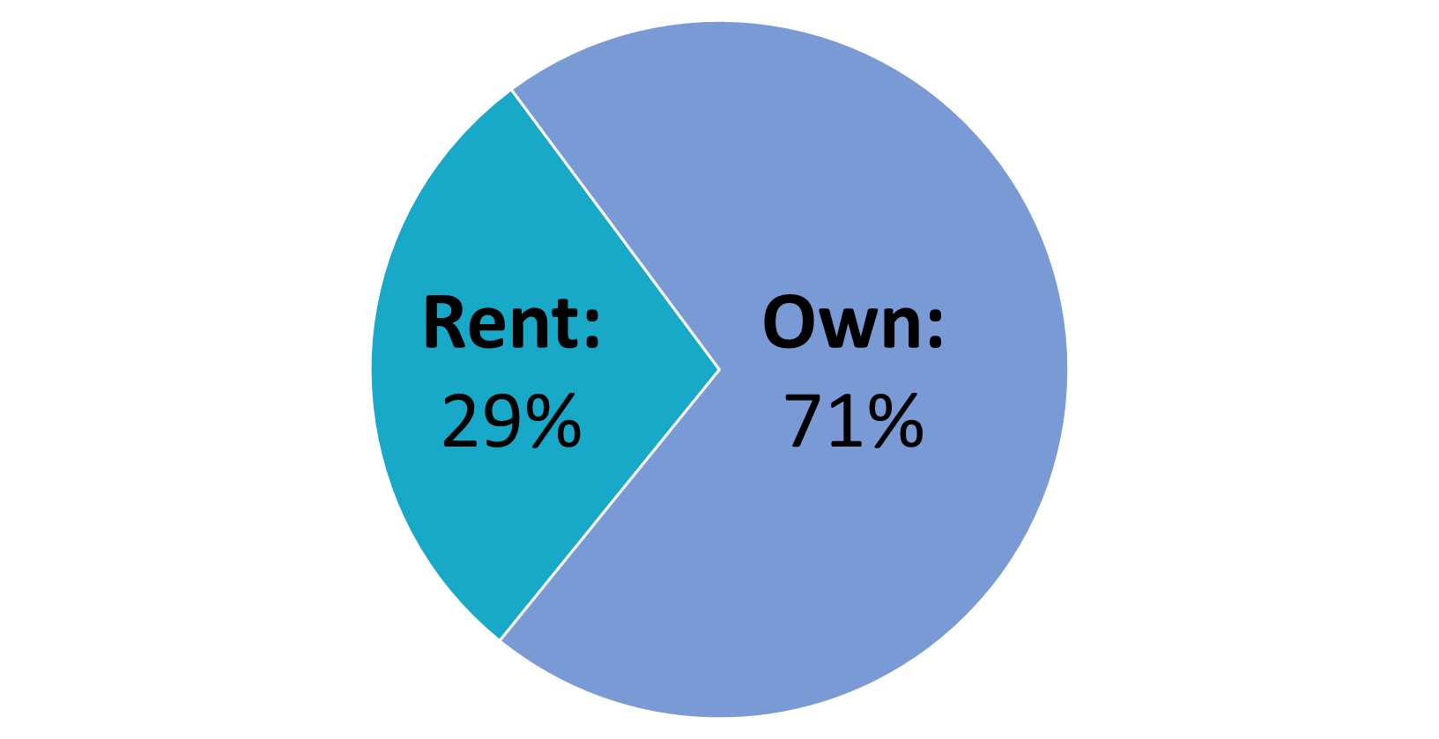
Who Lives in San Carlos?
Population in 2018: 30,364
Median Age: 42
Source: U.S. Census Bureau

Slide 13
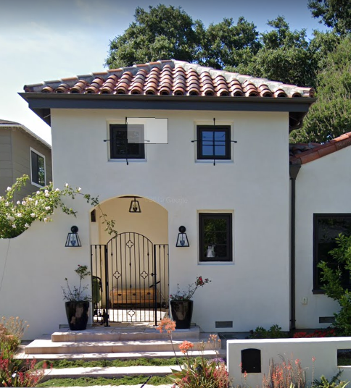
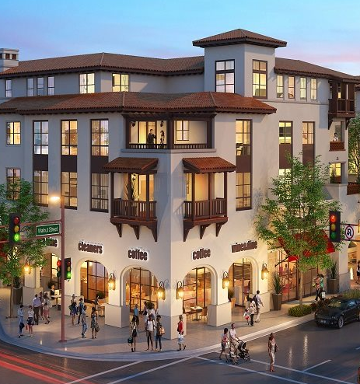
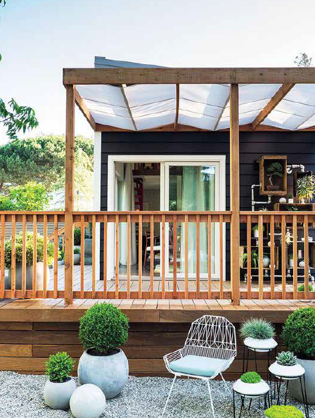
Housing Types
Total Housing Units: 11,894
8,683
Single Family Homes
73%
3,093
Multifamily units
26%
119
ADUs
1%
Source: U.S. Census Bureau
Notes:
Mention quick definition of ADUs- otherwise known as second units.

Slide 14
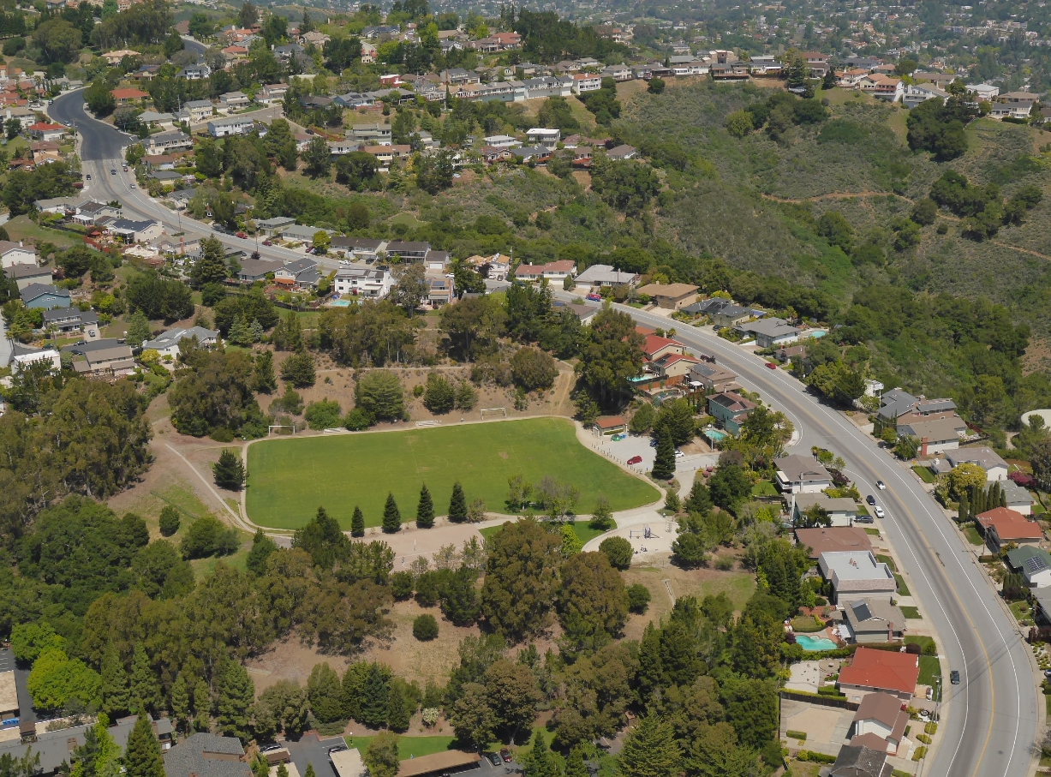
Ownership and Rental Costs
Median Home Price: $2,025,000
Avg. Rent for a 1 bdrm: $3,730/mo.
Avg. Rent for a 2 bdrm: $4,635/mo.
Source: Nerdwallet.com
Source: Zumper.com

Slide 15

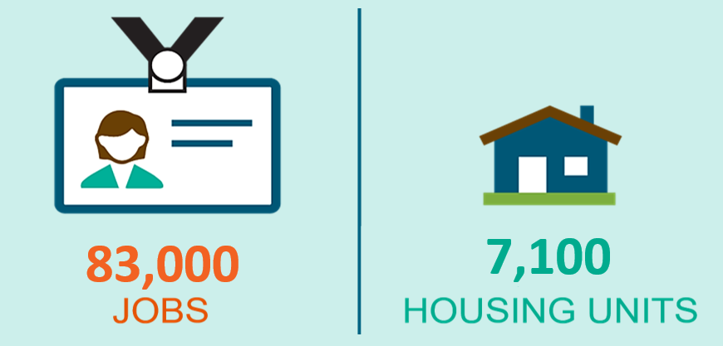
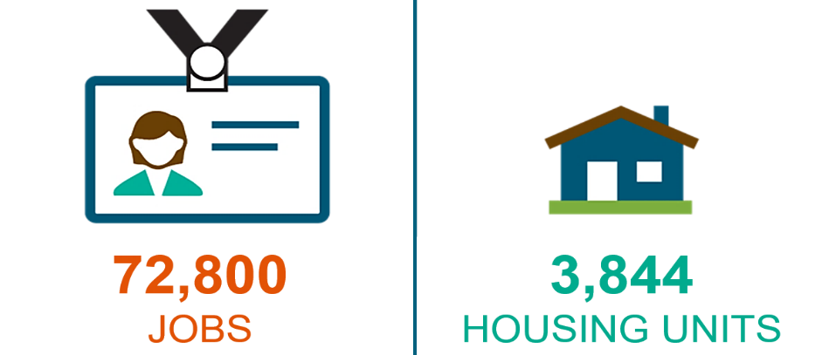
The Jobs/Housing Gap
San Mateo County Between 2010 – 2017
San Mateo County Between 2010 – 2017
Notes:
Between 2010 and 2017, 83,000 new jobs were created in San Mateo County, while only 7,100 new housing units were built, a 12:1 ratio.

Slide 16
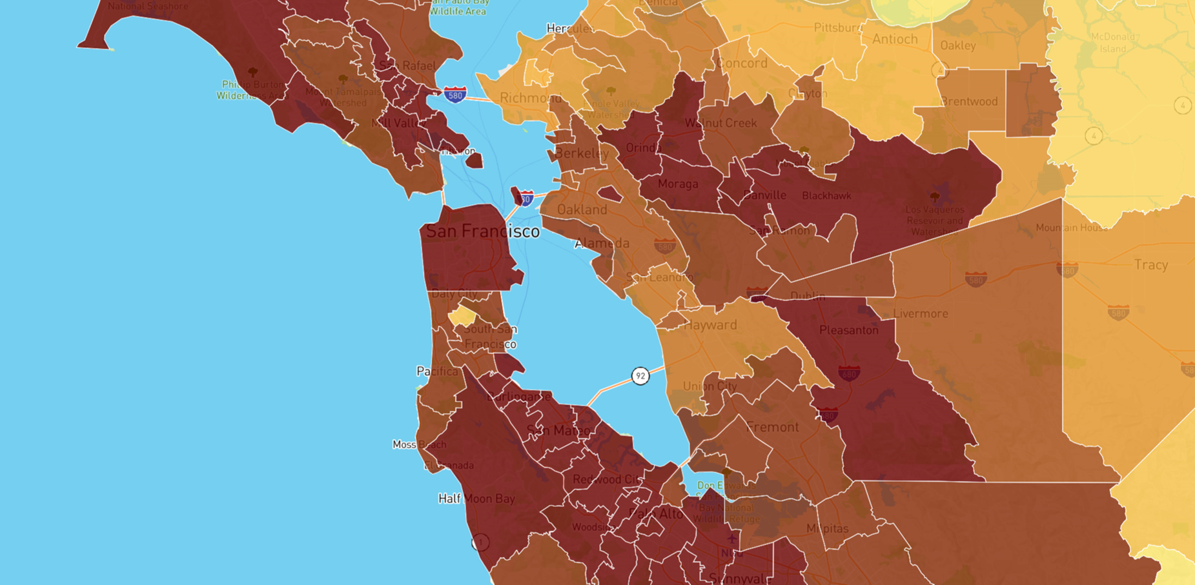
Long Commutes
An estimated 15,850 workers are employed in San Carlos
92% commute into San Carlos
8% live and work in San Carlos
Source: NeighborhoodScout, Nov. 2019
Notes:
Less expensive housing is only available far further away, requiring lengthy commutes and creating traffic congestion

Slide 17
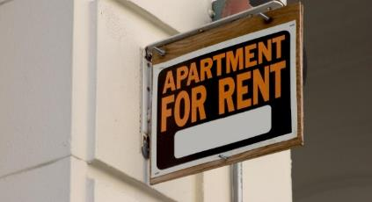
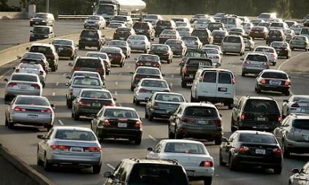
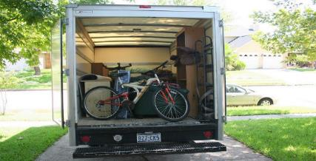
The Consequences in our County
2011 - 2017
  Median home price doubled
  2 bedroom apt. rent increased 66%
More than 210,000 people commute into
San Mateo County to work every day
2019 Bay Area Council Poll
  49% of respondents may leave the
  Bay Area within the next few years

Slide 18
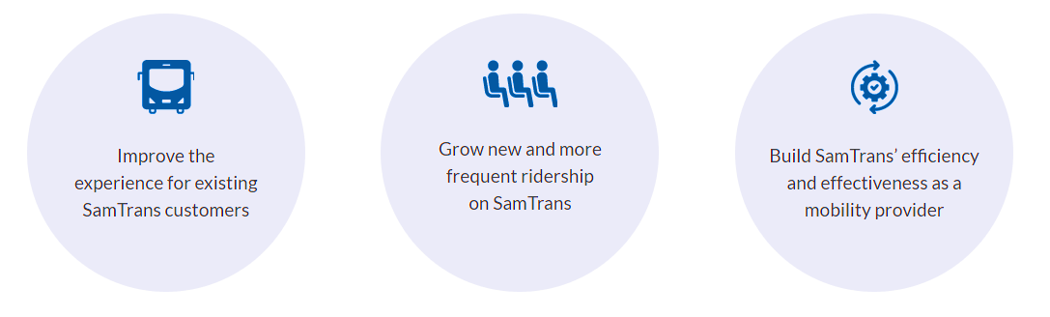
Reimagine SamTrans Goals
www.reimaginesamtrans.com
Notes:
The goals of Reimagine SamTrans are to improve the experience for existing SamTrans customers, grow new and more frequent ridership on SanTrans, and build SamTrans’ efficiency and effectiveness as a mobility provider.

Slide 19
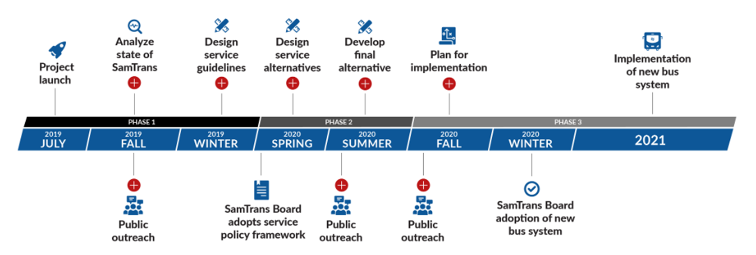
Reimagine SamTrans Timeline
www.reimaginesamtrans.com

Slide 20
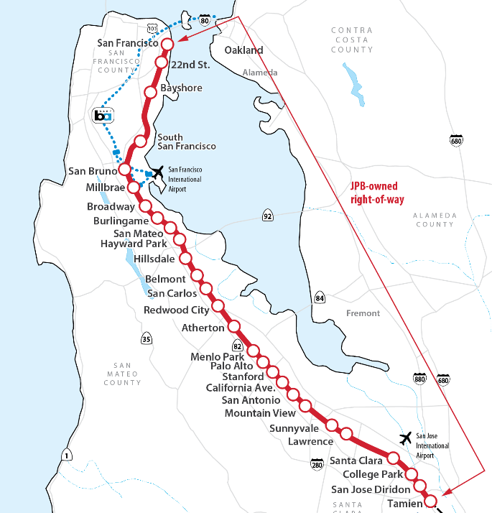
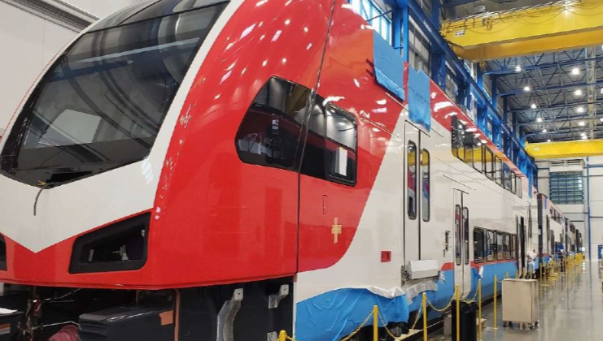


Caltrain Electrification (2022)
Project Area
Project Benefits
Improved Train Performance, Increased Service and Greater Capacity
Improved Regional Air Quality and Reduced Greenhouse Gas Emissions
Positive Economic Benefits for the Region
Reduced Engine Noise Emanating from Trains
Increased Revenue and Reduced Fuel Cost
51 miles
San Francisco to San Jose
(Tamien Station)

Slide 21
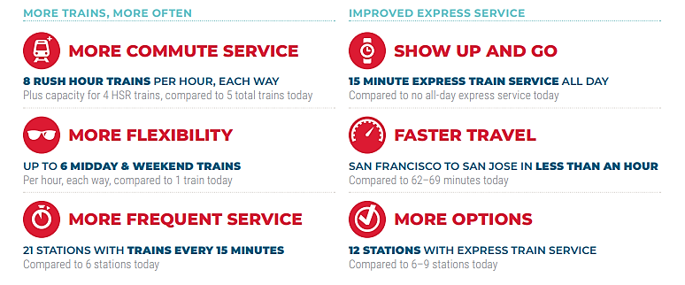
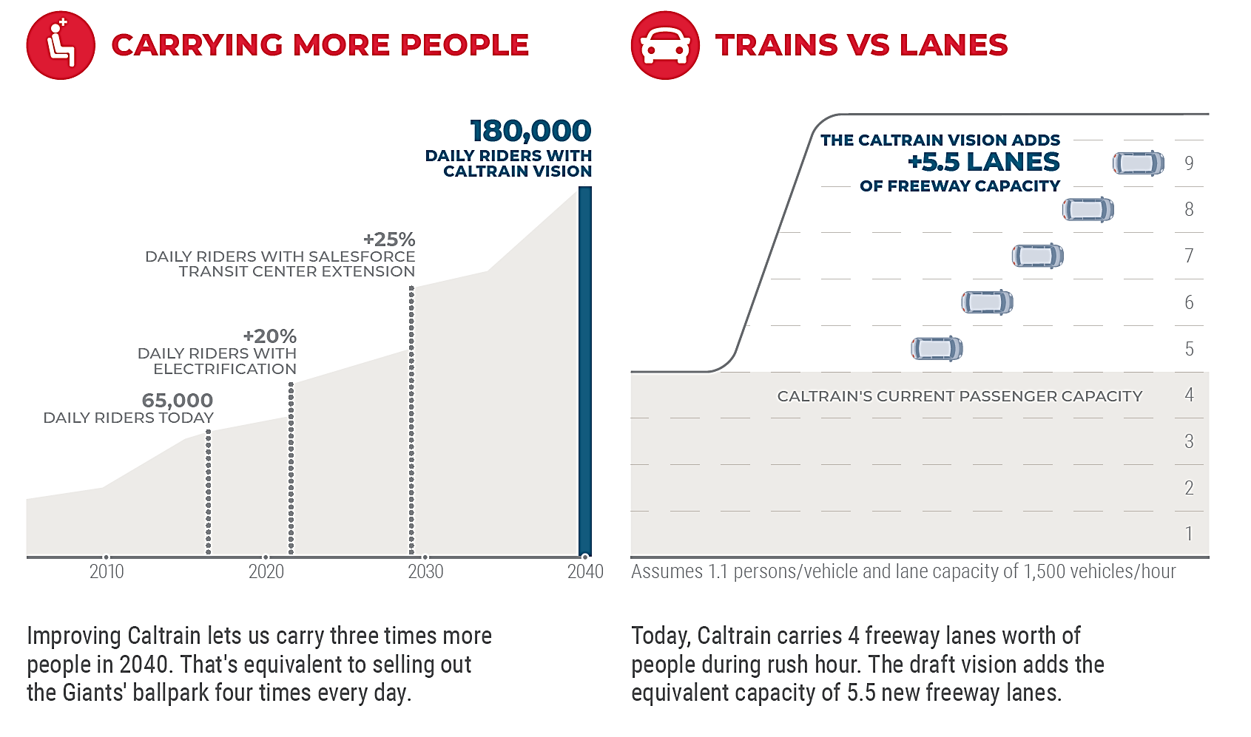
Caltrain Business Plan
(Board Adopted Vision 2019)
By 2040, 1.2M people & jobs w/in 2 miles of Caltrain (40%+)
Caltrain2040.org

Slide 22
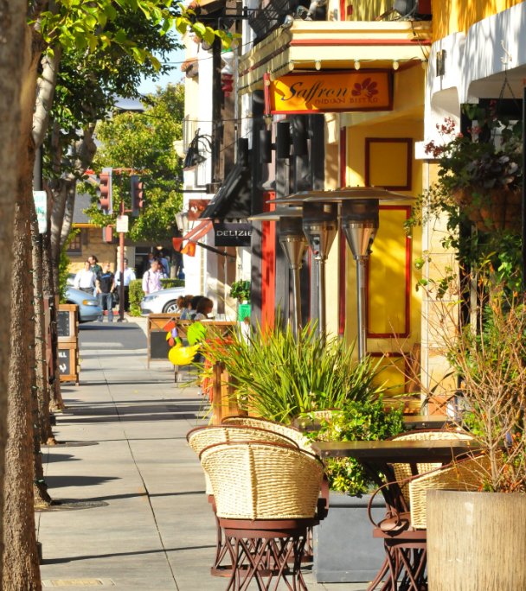
Table Discussion #1
What transportation options do you hope to see in San Carlos?
How can our community work together to reduce traffic and improve mobility?

Slide 23

New State Funding and
Housing Laws
“If we want a California for all, we have to build housing for all.”
Increase the number of below market rate (BMR) housing units to meet local and regional
housing requirements
Study land use and other regulatory options to increase all types of housing.
Notes:
The State recently passed a number of new housing. When we work together locally, it is important to understand how the planning parameters are changing at the state level. State government has a goals of building 3.5 million new homes by 2025, stronger support for tenants, significant investment in affordable housing, and state action on homelessness.

Slide 24
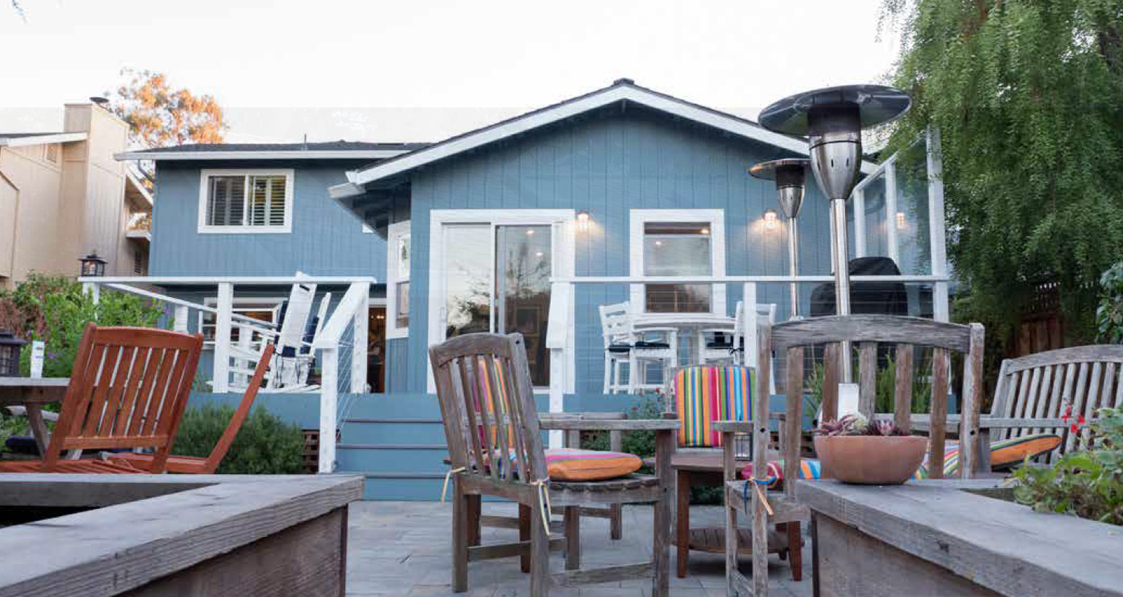
New State Funding and Housing Laws
Accessory Dwelling Units (AB 670, AB 68, AB 881, & SB 13)
  Streamlined review and approval process
  Amnesty program
  Homeowners Assoc. cannot ban ADUs
  No more owner occupancy rules
Notes:
Accessory Dwelling Units (ADUs) are defined as independent living quarters for one household with full facilities for sleeping, eating, cooking, and sanitation on the same lot as a primary single-family dwelling. The ADU may be attached, detached, or located within the living areas of the primary dwelling unit on the lot. While California laws have paved the way for increased ADU development, some cities have ordinance that render ADU development infeasible or cost prohibitive. By further reducing barriers to ADU development, the new bills are aimed to encourage the construction of more ADUs. The new laws help streamline the review and approval process, help unpermitted ADUs gain amnesty, have lenient development standards, no impact fees, allow one ADU and JADU per lot, and exempt owner occupancy rules. To learn more come to the ADU Planning Commission meeting at the end of the month or visit the ADU webpage on the city website. I’ll talk more about how the City is updating the ordinance to comply with these new state laws.

Slide 25
New State Funding and Housing Laws
Production and Preservation of Affordable Housing
2018 State Props 1 & 2 added $6 billion in bonds
2019 Budget allocated $2.7 billion for housing & homelessness
SB 330 Streamlines housing application process and timeline
*SB 50 Bill for Transportation Oriented Development (Failed at the Senate)
Protecting Tenants
SB 329 Prohibits discrimination against source of income (Section 8 vouchers)
AB 1482 Limits rent increase and adds just cause eviction
Notes:
State has increased funding for affordable housing and homelessness. This the most money the government has put out in a really long time which emphasizes the seriousness of the housing priority- such a high priority for the governor and legislature.
2018 ballot measures include Proposition 1: Veterans & Affordable Housing Bond Act ($4 billion) and Proposition 2: No Place Like Home ($2 billion).
2019 Budget & Trailer Bill: $2.7 billion for housing & homelessness
SB 330 streamlines the housing application approval process and timeline
SB 50 requires zoning changes for transit oriented development (TODs) which is still pending
Additionally,

Slide 26

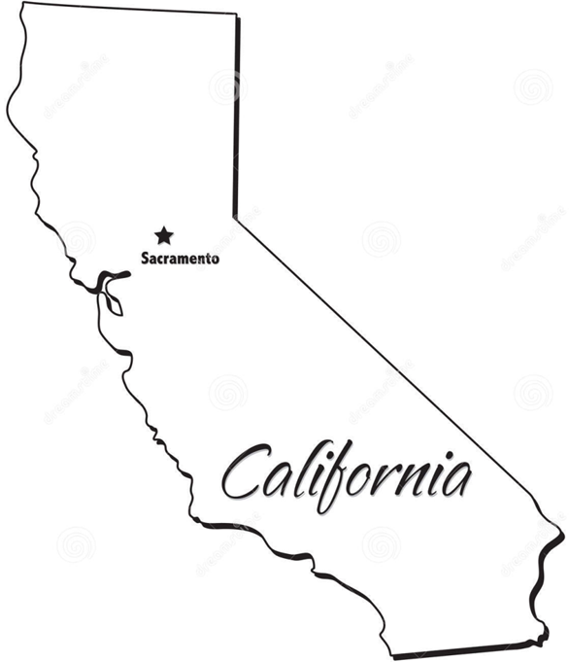

City of San Carlos
RHNA Goal 2015-2023
RHNA
Regional
Housing
Needs
Assessment/Allocation
Current Goal = 596
Notes:
By state law, all jurisdictions are required to plan to meet the housing needs of everyone in the community for an 8 year period.
HCD worked with regional Council of Governments (ABAG), Sustainable Communities Strategy Housing Methodology Committee (local officials, staff, stakeholders) deliberated for over a year on how to best distribute the region’s 187,990 unit housing needs allocation. San Mateo County worked as a subregion to allocate its 16,418 units amongst the 21 jurisdictions (20 cities and the county). Of 16,418 San Carlos received its fair share of 596 units. RHNA for 2022-2030 for the Bay Area is currently underway and will be much bigger!!

Slide 27
Options for San Carlos
Increase the number of below market rate (BMR) housing units to meet local and regional
housing requirements
Study land use and other regulatory options to increase all types of housing.

Slide 28
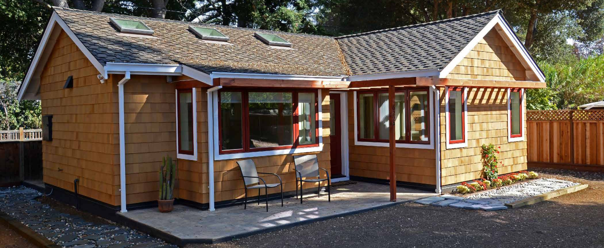
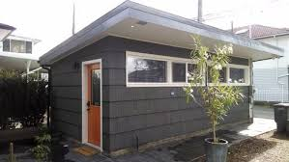
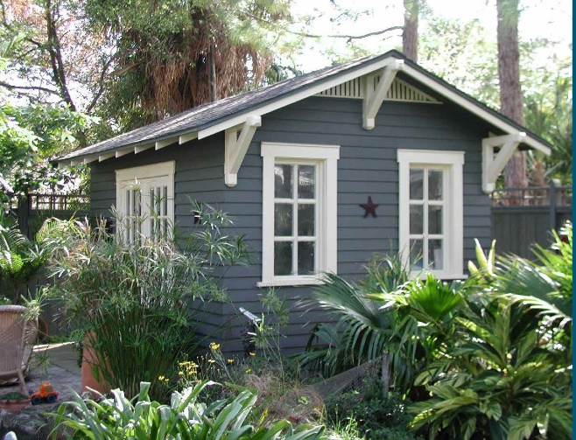
Update Accessory Dwelling Unit (ADU) Ordinance
SUMMER 2019-SPRING 2020
Bring San Carlos up to date with new state laws.
Planning Commission and City Council: March-April 2020
Cityofsancarlos.org/ADU
Notes:
Talking Points:
To comply with the new state laws, the City began the process of updating the ordinance. We had a study session on Oct. 2019 with high attendance and a robust discussion on the new laws.
Per PC direction to address concerns expressed by residents related to the state’s flexible parking requirements, staff took the ADU item to the Transportation and Circulation Commission in Dec. 2019.
The upcoming PC hearing scheduled for early march will include a redlined draft of the new ordinance that complies with the new state laws. Staff will also present graphics and visual exhibits associated with the various ADU types to better articulate the maximum size and scale of single-family homes developed with an ADU.
After the PC, the ordinance needs to be adopted by City Council anticipated for late March 2020.
Find out more on the ADU webpage at cityofsancarlos.org/ADU

Slide 29
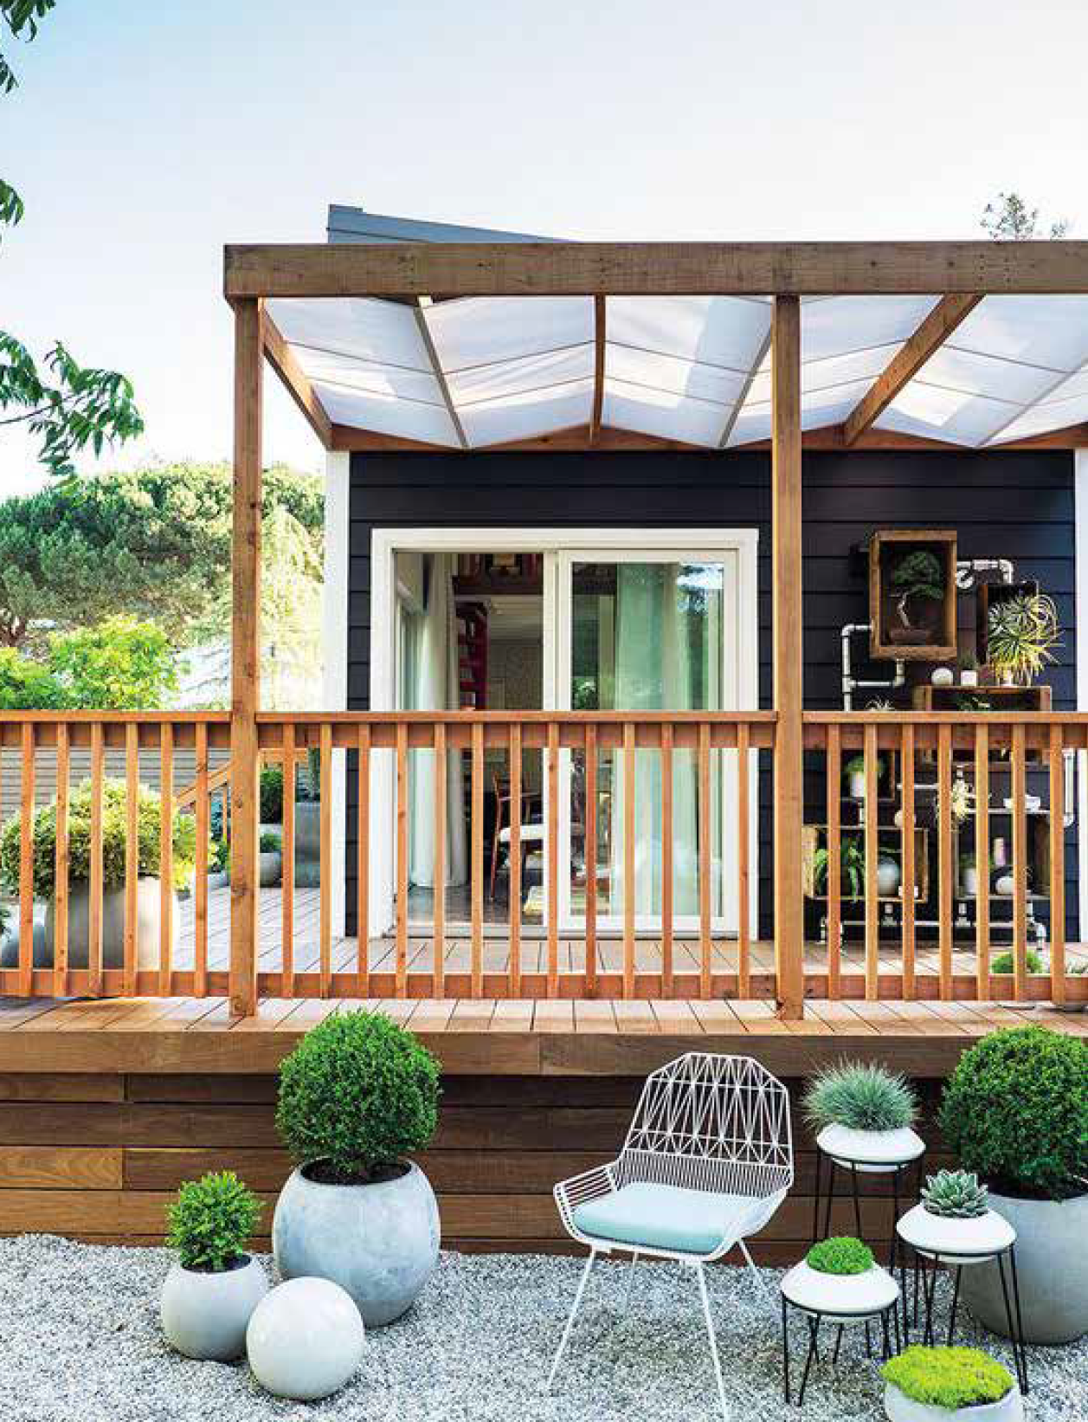
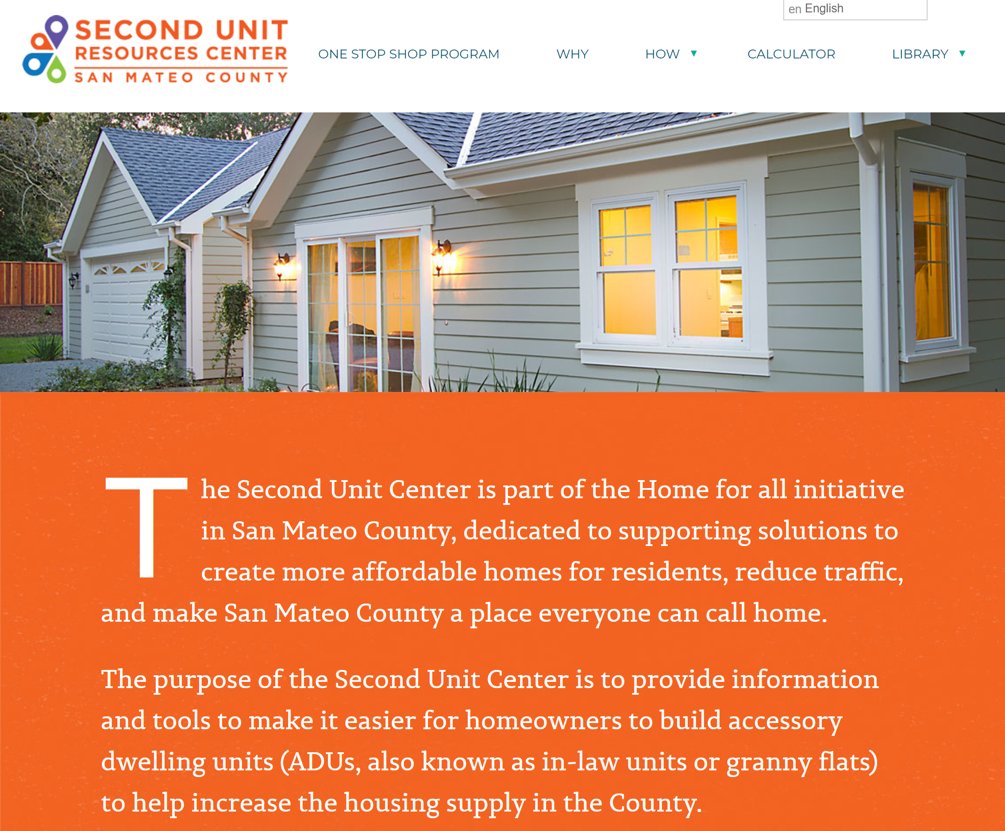
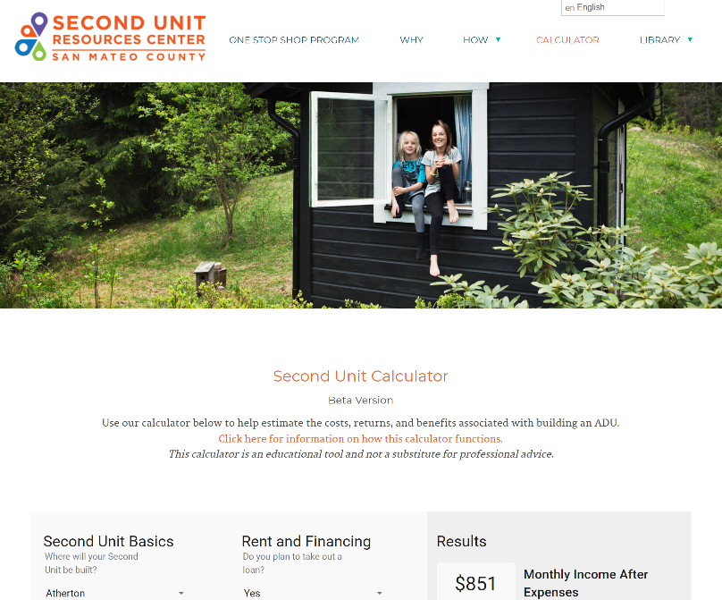
Connect Residents with ADU Resources
If you’re interested in building an ADU,
visit the San Mateo County Second Unit Resources Center at
secondunitcentersmc.org

Slide 30
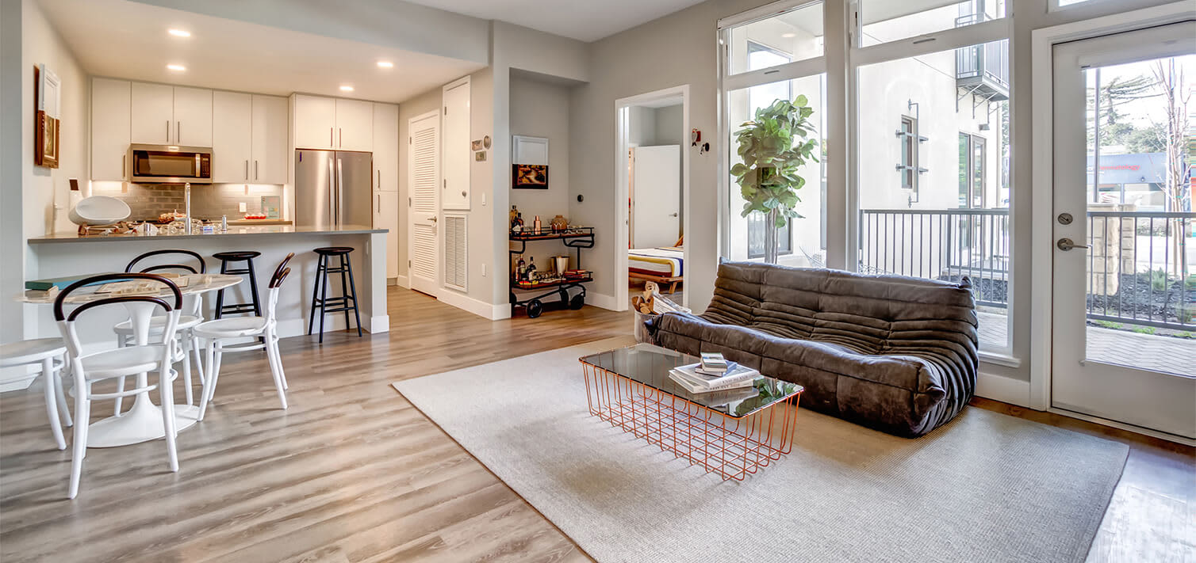
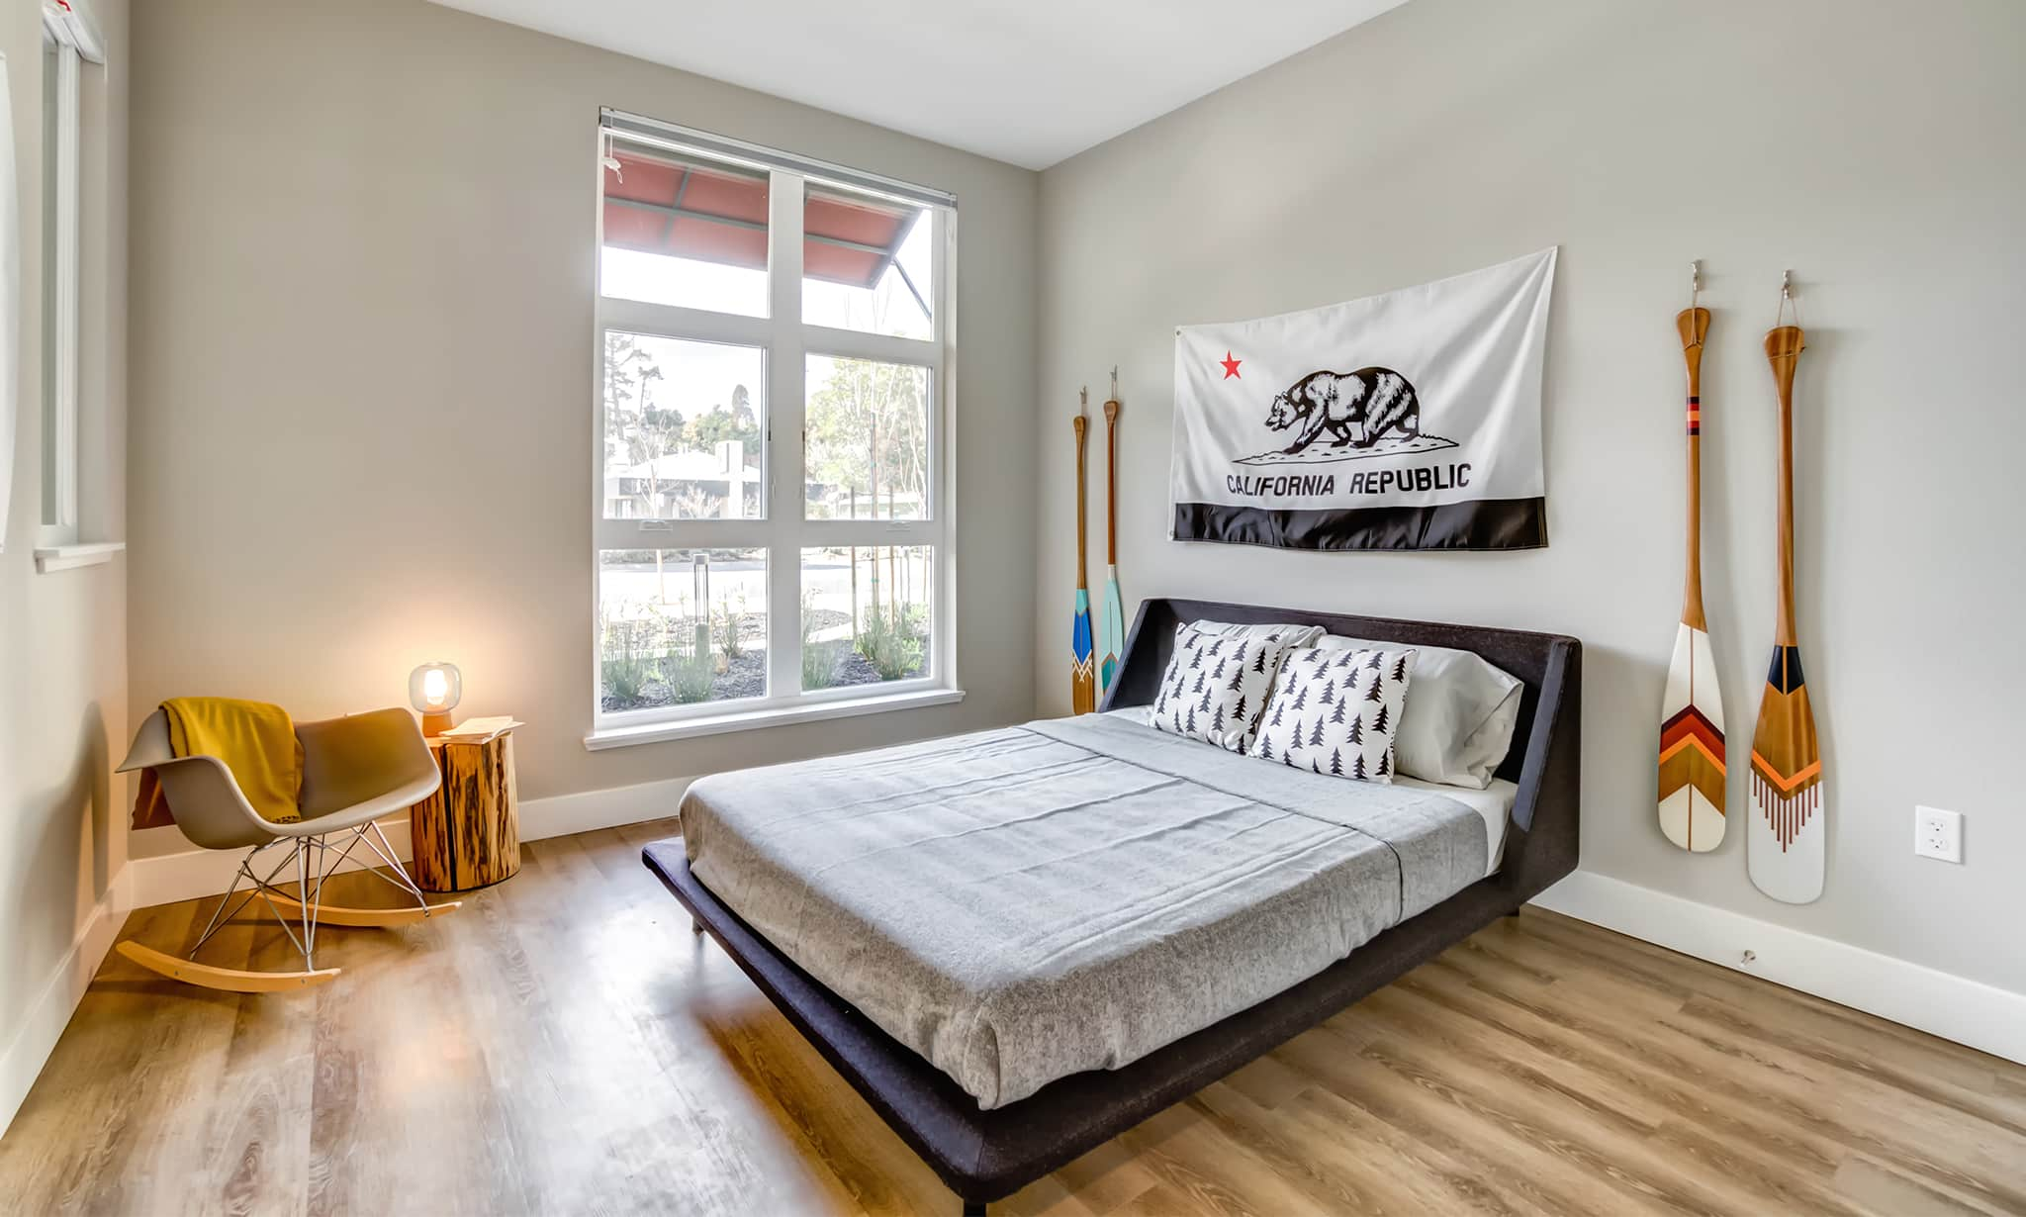
Update Below Market Rate (BMR) Ordinance
SUMMER 2020
We are studying ways to maximize the number of affordable units being built.
Last year, City Council amended laws to require developers to include (BMR) units in residential rental developments and eliminated the in-lieu fee option
Trestle Apartments
333 El Camino Real
Notes:
On July 8, 2019, the City Council amended the Municipal Code to encourage the construction of more affordable housing. Developers will now be required to include Below Market Rate (BMR) units in residential rental developments. The changes also eliminate “in lieu” fees, which developers could previously pay as an alternative to building BMR units. Other upcoming updates include fee waiver considerations and relevant state regulation updates. The City is currently conducting an economic study to review affordable housing requirements, such as percentage and level of affordability. The study will also evaluate incentives and alternatives that could help increase the amount of affordable housing.

Slide 31

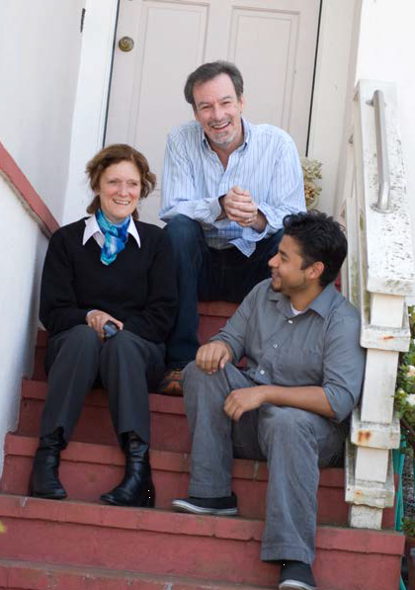
Shared Housing
“HIP Housing matches people who have space in their home with people needing an affordable place to live.”
For more information, visit hiphousing.org
Notes:
Here are some affordable housing resources.

Slide 32
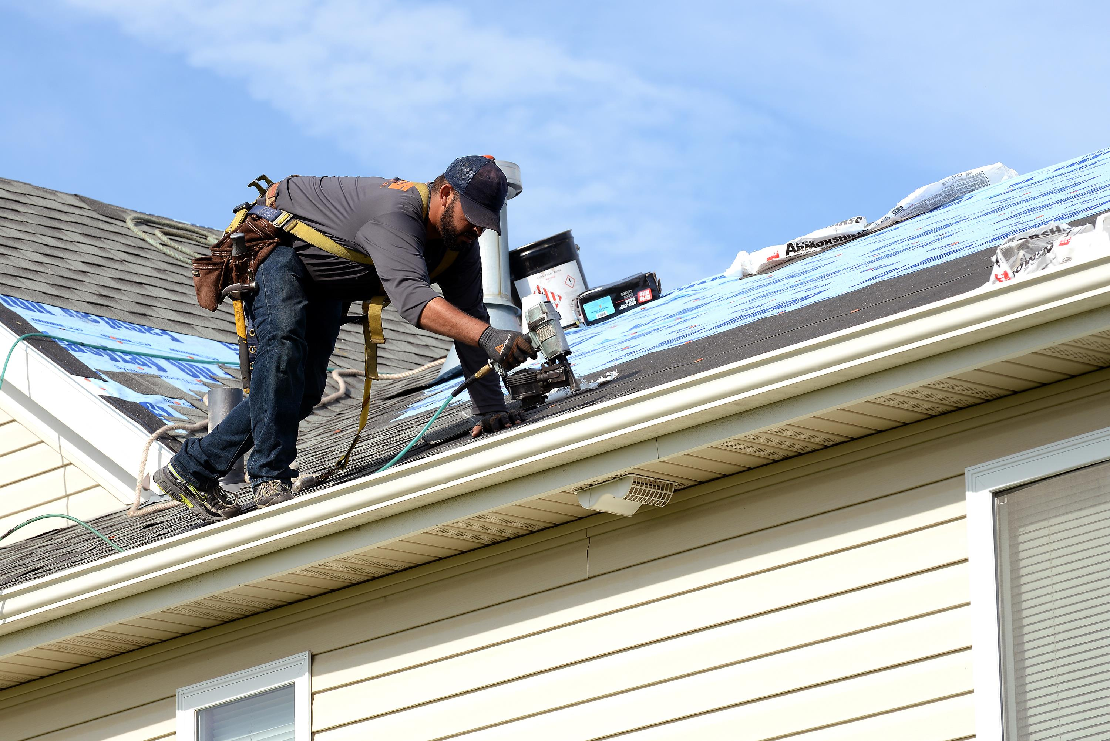
Support for Renters and Homeowners
“Provide additional support to renters and homeowners.”
Emergency assistance paying rent or utilities, relocation assistance, help with repairs and modernization, tenant and landlord counseling,
legal help, volunteer support, etc.
Programs such as Rebuilding Together Peninsula offer free home repairs for qualified homeowners
Notes:
More resources.

Slide 33
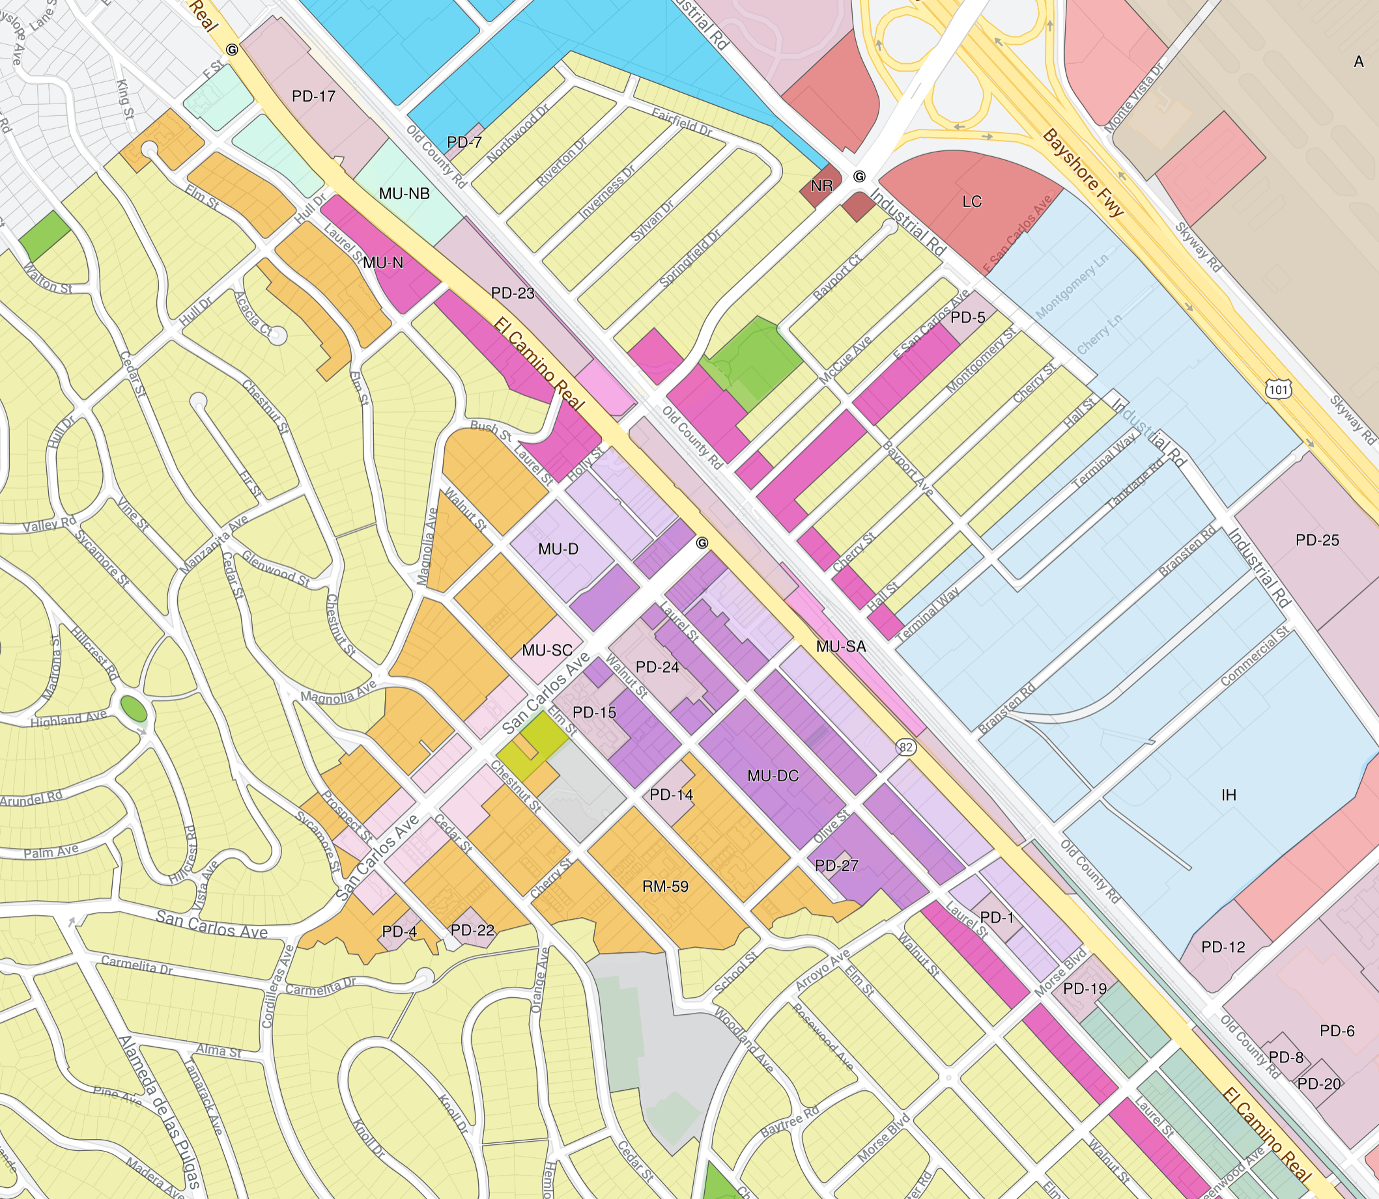
Update the General Plan and Zoning
SUMMER 2019-SPRING 2020
We are looking for creative ways to use land already zoned for housing.
Review the General Plan and Zoning to identify where changes in density can occur
Increase housing supply

Slide 34
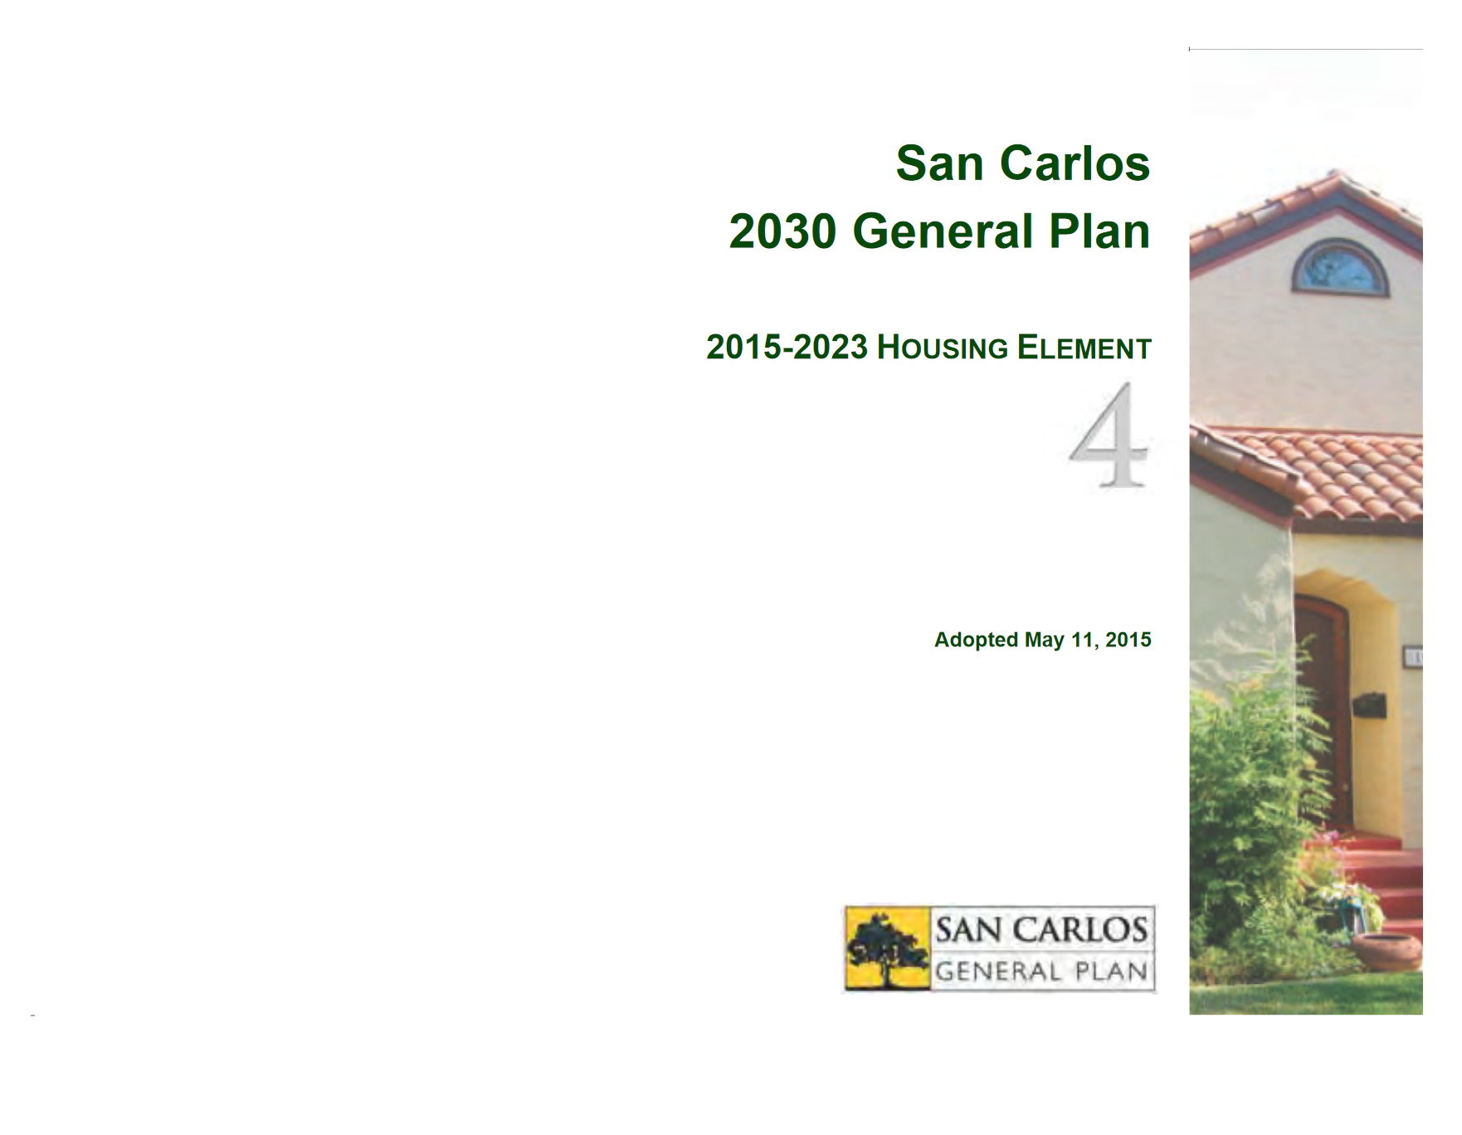
Update the Housing Element
SUMMER 2023
“We will update the City Housing Element by 2023.”
The Housing Element describes how the city will meet its housing goals.
Community input is an essential
part of this planning process.
Notes:
This document provides an analysis of the community’s housing needs and describes plans for how to achieve the City’s housing goals. This element must be updated every 8 years to respond to current and near term future housing needs.

Slide 35


More initiatives!
SUMMER 2020
Economic Development Plan Update
Childcare
Bicycle and Pedestrian Master Plan
Notes:
In addition to the initiatives directly related to housing, the City is also pursuing other projects related to housing, transportation, and the quality of life.
The 2016-2019 Plan includes three long-term overarching economic development goals, five themes to guide investment and inform resource allocation, and 24 near-term initiatives. These goals, themes, and initiatives are currently in the process of being updated for the 2020-23 plan and is anticipated for completion this summer.
Childcare is also a council priority and staff has prepared a work plan related to child care policies with the goal of increasing the supply of spaces in the City anticipated for Council review in early March
The City is also developing a Bicycle and Pedestrian Master Plan. The process started in Fall 2020 with review of existing conditions, community input, and recommendations. The final plan is anticipated for council review in the Spring.

Slide 36

Table Discussion #2
As we think about upcoming planning efforts and the future of San Carlos, what kind of community do you want to live in? Why is that important to you?
  What hopes do you have?
  What concerns are coming up for you?
How else can we work together to better support renters, landlords and homeowners?
Notes:
Here’s where we are today, and how we got here today.

Slide 37
Next Steps
City staff will:
Email and post report of today’s conversation at housing website: cityofsancarlos.org/welcomehome
Add information and updates that people have requested
Community members are invited to:
Provide input on our Shape San Carlos Forum
Participate in upcoming City Council, Planning Commission, and other committee meetings
Notes:
Check out the website for a summary of today’s discussion in the next few weeks
Updates will be added to the website with information people requested including links to the various resources related to ADUs, shared housing, and resources for renters and homeowners. There is also more information in your take-home folders. Additionally, more information presented by the San Mateo County Transit District on SamTrans and Caltrain can be found at the table near the check-in. Community members are encouraged to keep the conversation going by attending future cc, pc, and other committee meetings.

Slide 38


What’s Happening Next
March-April 2020
ADU Ord. Update
Childcare
July-Sept. 2020
BMR Ord. Update
Economic Dev. Plan Update
Summer 2023
Housing Element Update
April-June 2020
Bicycle and Pedestrian Master Plan
Fall 2022
GP and ZO update
Notes:
We have a productive year ahead of us with some important items going to the Planning Commission and City Council all directly or peripherally related to housing.

Slide 39
Stay Involved
Learn
Join
Share
Continue
Learn more about upcoming City initiatives related to housing
Join the housing email list
Share what you have learned with others
Continue to stay engaged by coming to future City and Community meetings and events
cityofsancarlos.org/mysc
Notes:
Continue to stay involved by learning more about the upcoming City initiatives related to housing. Make sure to join the housing email list to get updates. It’s really important that you share what you learned today and throughout the Welcome Home initiative with community members. And most importantly, continue to stay engaged.

Slide 40

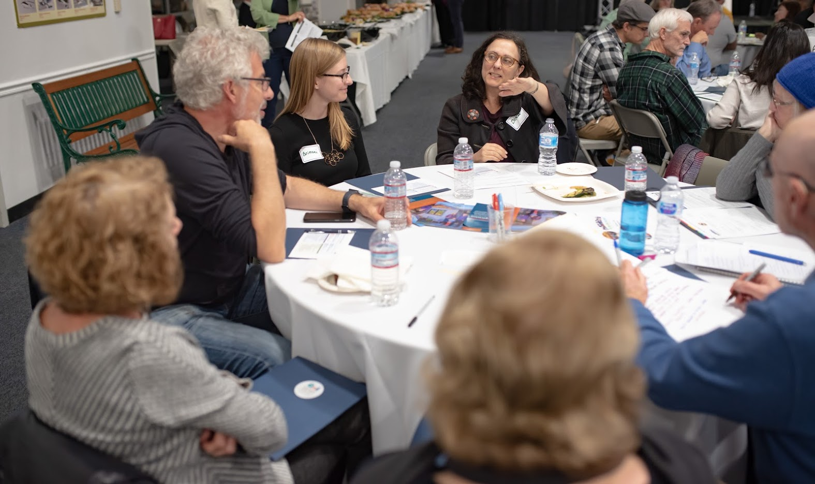

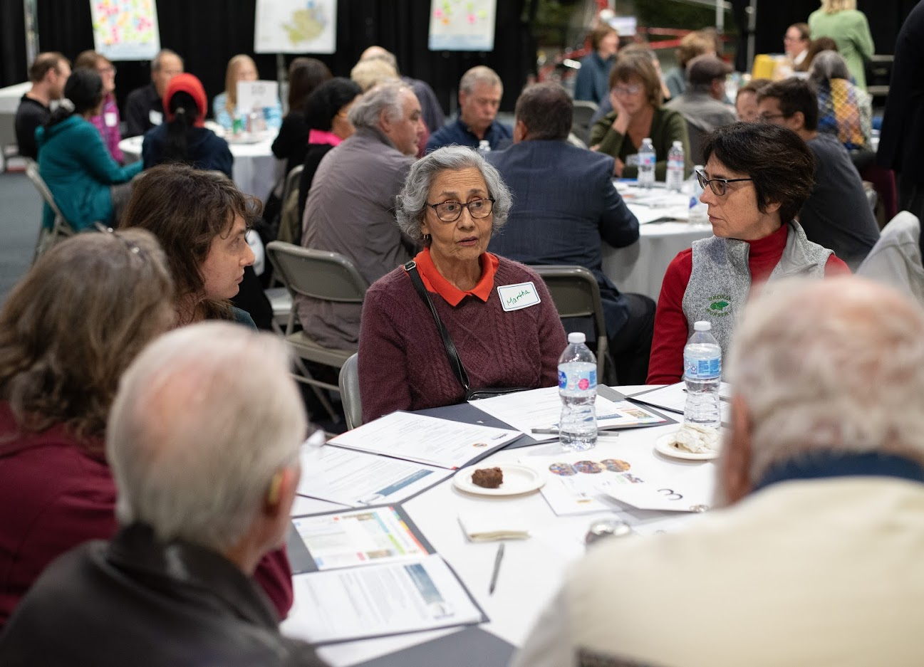
Thank You for Coming Today!
www.cityofsancarlos.org/welcomehome
Notes:
Please visit our website to stay updated on Welcome Home San Carlos efforts:

Slide 41
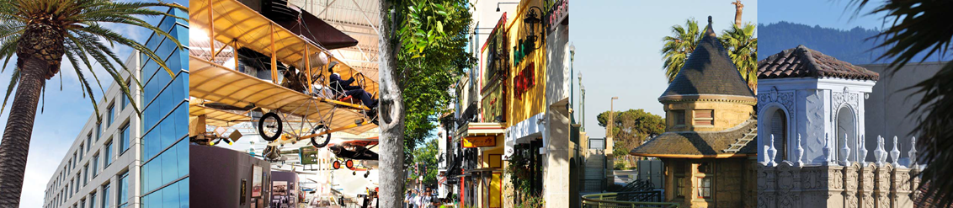

Questions?
City staff are available for specific questions

