Slide 1
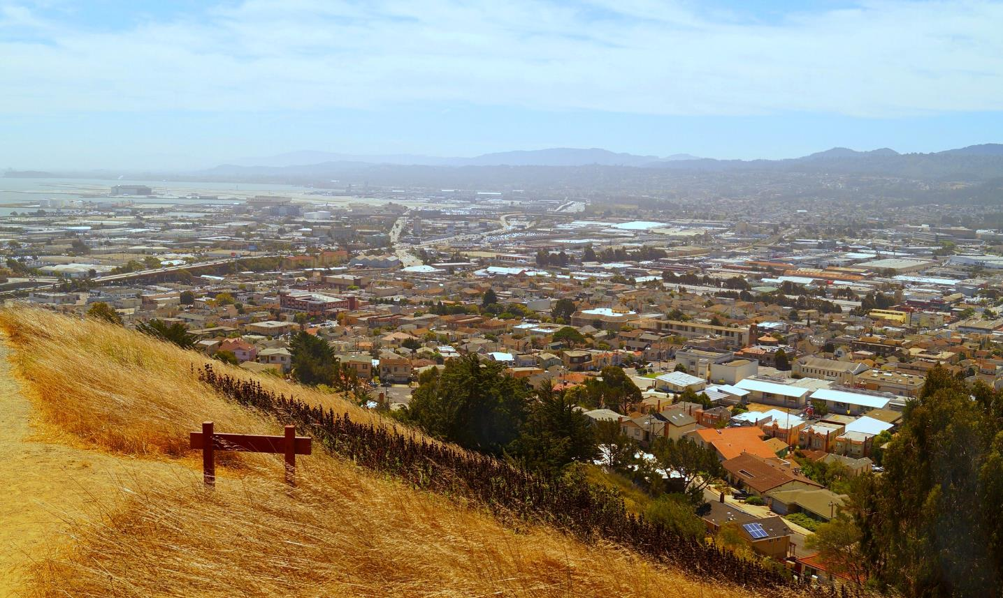
Where We Are Today
San Mateo County

Slide 2
Home for All
A community collaborative addressing the housing challenge in San Mateo County by promoting the preservation and production of all types of housing

Slide 3
Goals
Close the 24:1 Jobs/Housing Gap
Add 16,500 new housing units of varying levels of affordability between 2014 and 2022

Slide 4
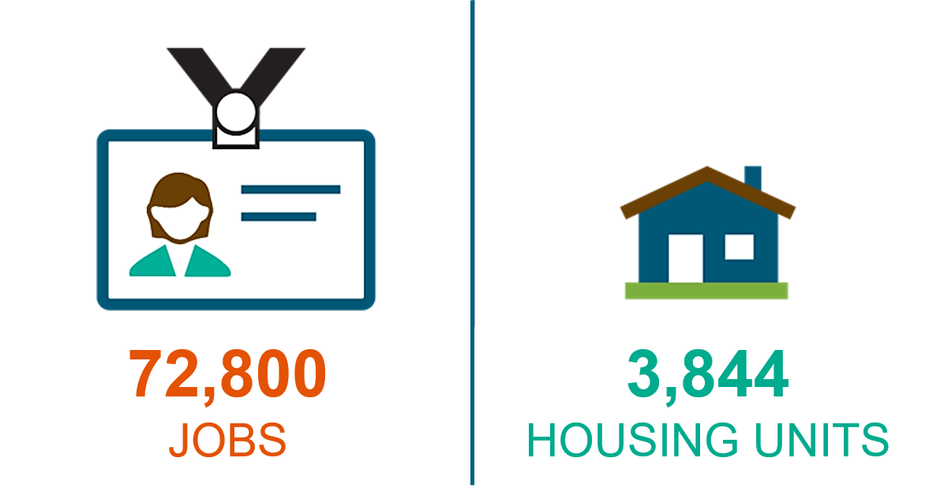
The Jobs/Housing Gap
San Mateo County Between 2010 – 2018
93,000
8,500

Slide 5
San Mateo County RHNA 2014-2022

Slide 6
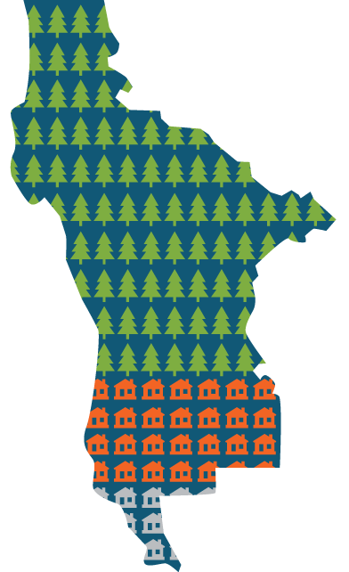
Land Use Opportunity
The majority (68%) of San Mateo County’s land is preserved for open space and agriculture.
Of developed land, more than 2/3 of the current housing stock is single family homes.

Slide 7
Innovative Strategy
Can house family, friends, community members
Use can evolve with family needs
Additional income to homeowners
Affordable housing opportunity
Environmentally friendly
Eases traffic
Notes:
Strategy to address various housing challenge
Affordable Housing
Environmentally Friendly
Can house family, friends, community members
Use can evolve with family needs
Additional income to homeowners
Alleviates traffic

Slide 8
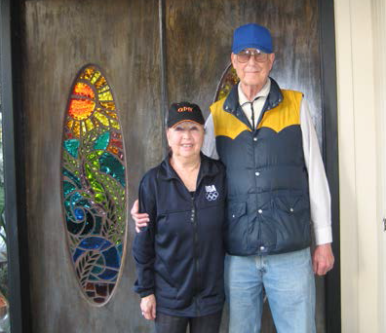
A Community Solution

Slide 9
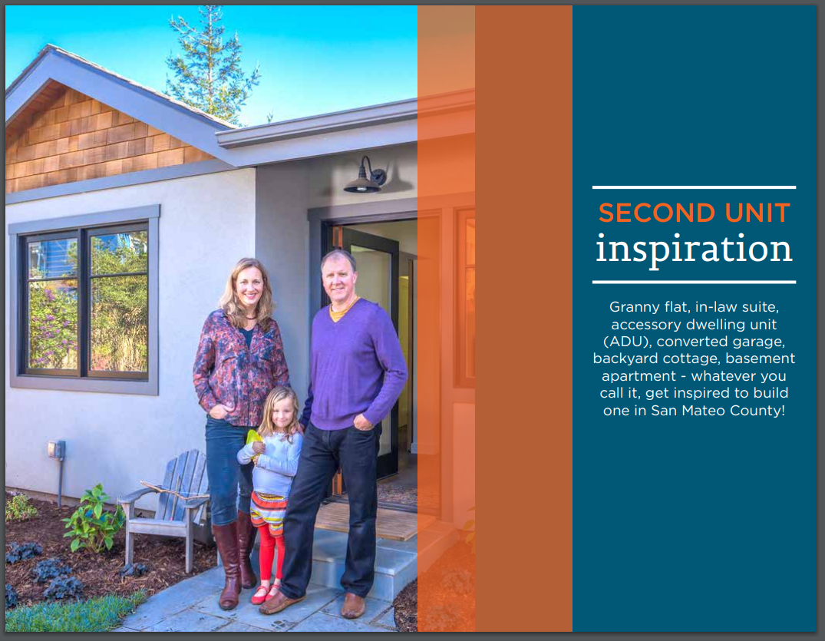
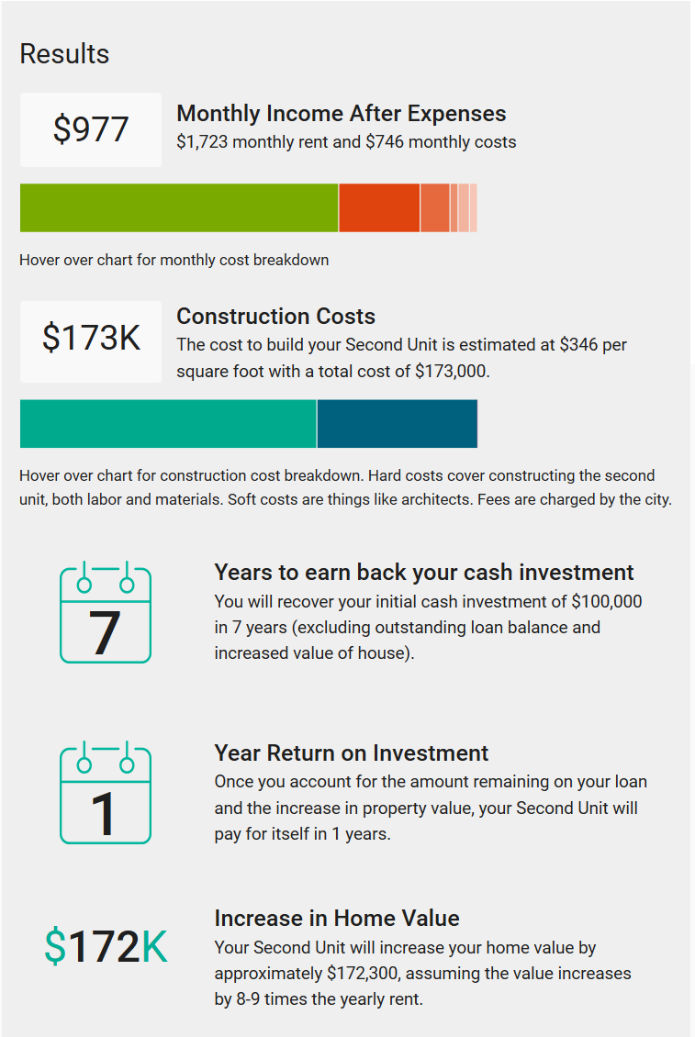
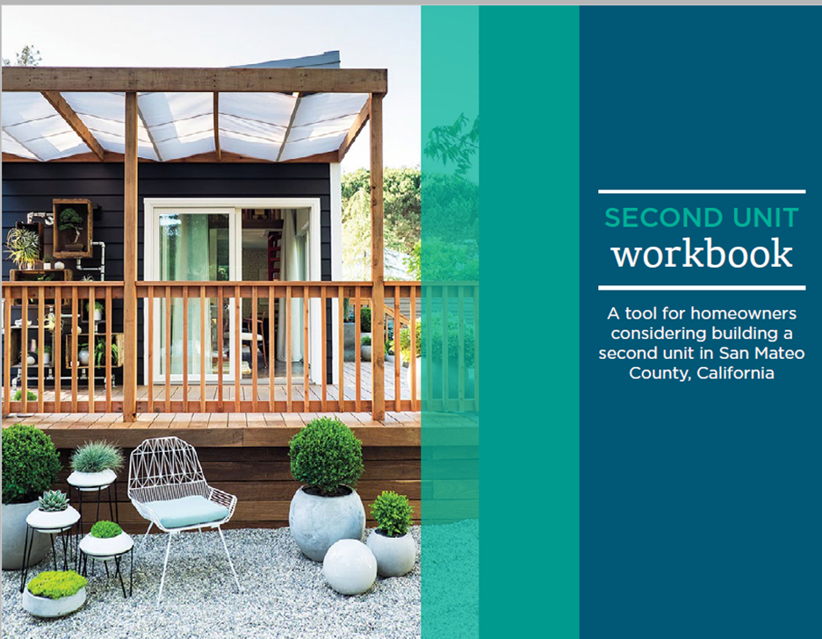
Second Unit Resources
Notes:
Second units priority from the Jobs-Housing Gap task force – a main focus of work
Second Unit Center – responding to focus group needs and cities requests
Includes material from inspiration and workbook – these plus the calculator have been adopted by other jurisdictions
Testimonials/Videos of why and benefit of building an ADU
Information on One Stop Shop Pilot Program
Single point to access all the tangible resources developed throughout the county
Site redesign – stepping off point into numerous resources developed by partners (which you will hear about today)
Why invest
How to do it

Slide 10
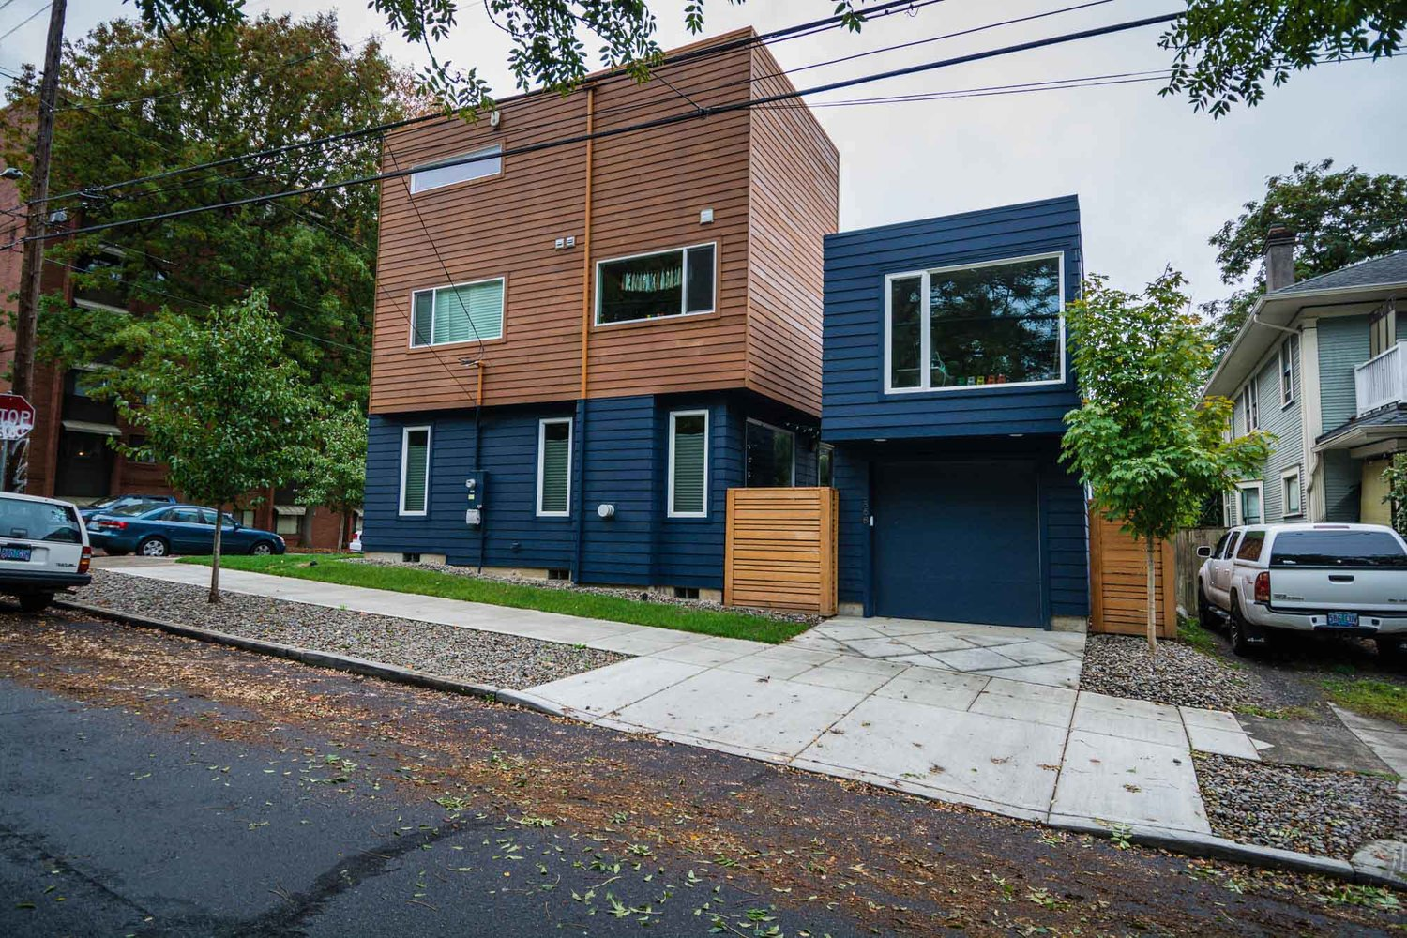
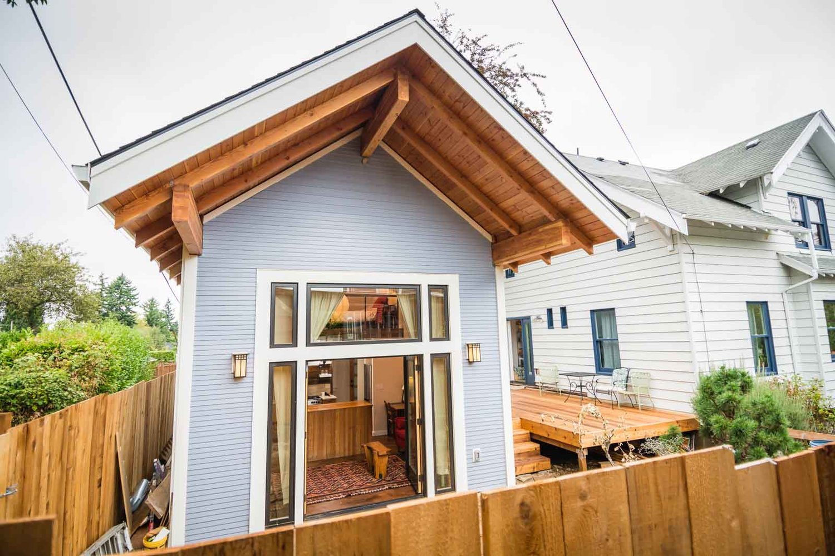
New ADU Laws
Notes:
New State laws encourage property owners to build ADUs and Junior ADUs by addressing
Streamlined review and approval process
Homeowners associations cannot ban ADUs or Junior ADUs
One detached ADU and one Junior ADU will be allowed by right on single-family lots
Units under 800 sf can be 16 feet tall and have a setback of four feet on side or rear of unit
No impact fees on ADUs less than 750 sf
Exemption from owner occupancy rules for ADUs with building permits between 1/1/2020 and 12/31/2024
Amnesty program: Mandatory 5-year stay of enforcement on unpermitted ADUs if meet health and safety standards
County amnesty pilot on ADUs to put homes into conformance on health and safety regulations

Slide 11
Housing Progress in San Mateo County

Slide 12
Second Units are Booming
Notes:
New state laws taking effect in 2018 and 2020 have eased the restrictions and approval hurdles at the planning counter, and more homeowners are seeing the benefits. Preliminary numbers for 2019 show 367 second unit permits issued county-wide.

Slide 13
San Mateo County RHNA Progress
*Required under CA Regional Housing Needs Allocation (RHNA) for 2015-23
Notes:
Source: 6/20/19 Steering Council Meeting

Slide 14
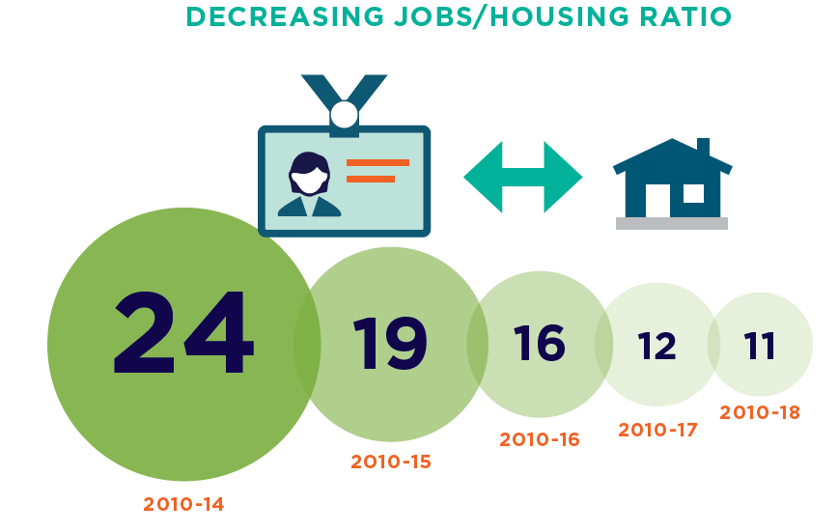
Closing the Gap
Notes:
We are continuing to address barriers associated with second units and learning from our neighbors on creative strategies they are employing to promote second units which you will hear about today. Every unit helps close the gap – still higher than Bay Area gap of 7:1 but we think this could be a great option to help close the gap.

